Slide 1
Parallelization of The 24 Game using Pthreads
Kevin Wang, Anthony Tu, Rahul Chander
EE/CSCI 451: Project Presentation
University of Southern California

Slide 2
Introduction
The objective of the game is to get to 24 using each number exactly once, through a series of mathematical operations (+ x ÷ –)
Where is the problem used? Why is it important?
Why is parallelization necessary?

Slide 3
Context
List the challenges in parallelization
Give some context regarding any existing parallel solutions (Skip If there are no existing solutions)

Slide 4
Objective
List the objectives/potential contribution of the project

Slide 5
Project Parallelization Hypothesis
Provide a hypothesis for the parallelization strategy of your project
Hypothesis is a short one line summary of what you are claiming to be true in this project.
E.g. Shared Memory in GPUs can be used to accelerate Matrix Multiplication by exploiting data reuse
E.g. Task parallelism is more suitable for algorithm xx than data parallelism due to the loop dependencies in the algorithm

Slide 6
Key idea
Explain the algorithm/solution identifying all the necessary parameters which can be tweaked to parallelize (e.g. parameters: number of threads, block size etc.)
Mention the programming platform you are using and the reason for selecting it.
Focus only on issues relevant to EE 451. All domain specific details should be given in intro/context slides.

Slide 7
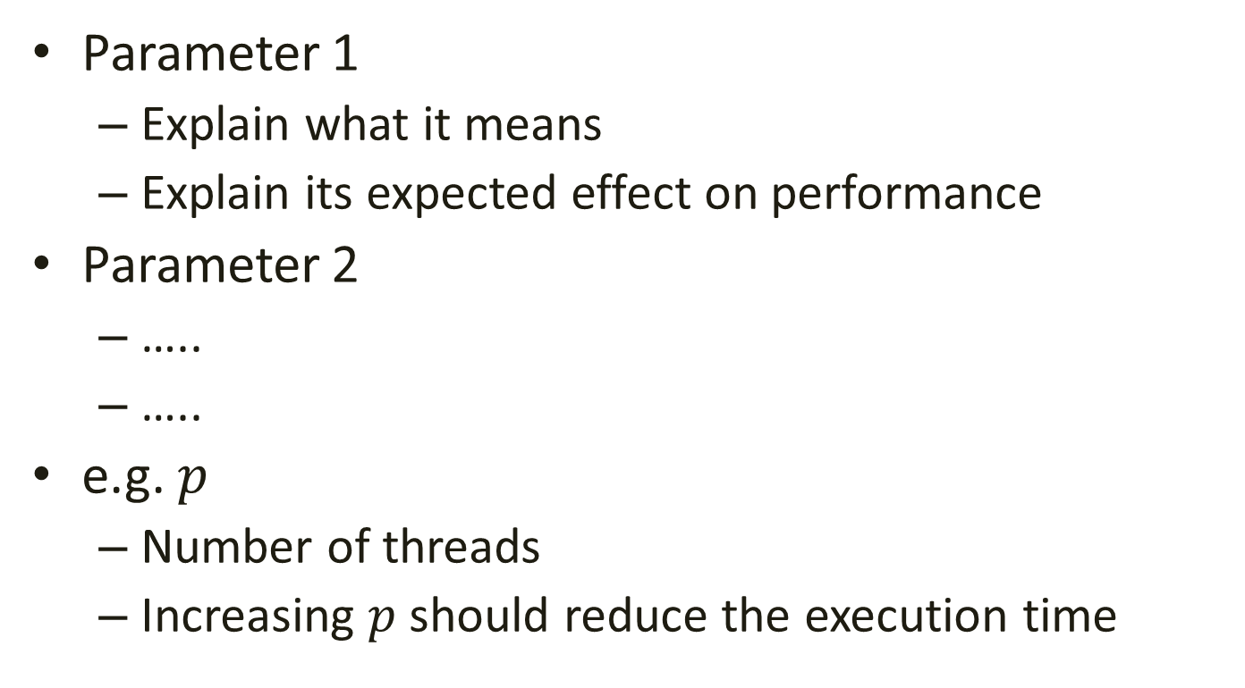
Explanation of Parameter
Parameter 1
Explain what it means
Explain its expected effect on performance
Parameter 2
…..
…..
e.g. $p$
Number of threads
Increasing $p$ should reduce the execution time

Slide 8
Experimental Setup
Explain the evaluation plan
Platform
Dataset used
The range of the values of each parameters

Slide 9
Results
Show the results obtained so far

Slide 10
Analysis
Provide analysis of the results obtained.
Explain how the parameters are affecting the performance.

Slide 11
Conclusion
Summarize what you learned (or expected to learn) by doing this project

